Slide 1

PROJECTS
TOPICS
TOPICS
SYSTEM UNDERSTANDING ADAPTATION/MITIGATION
COASTAL EROSION
SEDIMENT DEFICIT
RIVER FLOODING
FLOODING
PROGEP
MARINE FLOODING
FRESH WATER SHORTAGE
SALINIZATION
NAVIGABILITY
GROUNDWATER SALINIZATION
OMVS training
ENVIRONMENTAL DEGRADATION
LOCAL SCALE REGIONAL SCALE
LAND SUBSIDENCE
POOR WATER QUALITY
SERRP

Slide 2
Senegal delta: main threats and what causes them
DRIVERS STRESSES & CHALLENGES THREATS
Rainfall
Highly dynamic river and coastal system – rapid morpho. change
River flooding
River discharge
Navigation (safety problems &wish for harbor)
Infrastructural damage
Wave climate
Increasing energy demand
Loss of human life and health
Tide
Marine submersion
Wind
Increasing crop demand
Ecosystem degradation
Climate change
Especially:
Sea level rise
Changing river discharge
Coastal erosion
Reduction of agricultural production
Increasing fresh water demand
Surface water salinization
Population and economic growth
Increasing spatial demands
Groundwater salinization
Increase in navigation demands
Land subsidence
Pollution
Shortcut to sheet with news articles with examples

Slide 3
* Senegal River Watershed: 350000 km² * Shared between Guinea, Mali, Senegal and Mauritania * Length: 1800 km
Coastal erosion
River Flooding
Marine Flooding
Salinization
Navigability
Env. Degradation
POTENTIAL FOR ADAPTATION/MITIGATION
Reduce groundwater use
Stimulate groundwate recharge
Re-enable sedimentation on the delta plain
Value delta elevation as depletable natural resource
CURRENT SITUATION
Severely threatened by soil subsidence
Anthropogenic influences explain 65-92% of subsidence
Current best estimate of subsidence rate is 9 mm/yr
Some areas subside by over 25 mm/yr
FUTURE SITUATION
Large part of Mekong Delta will very likely be below sea level in the next 100 years

Slide 4
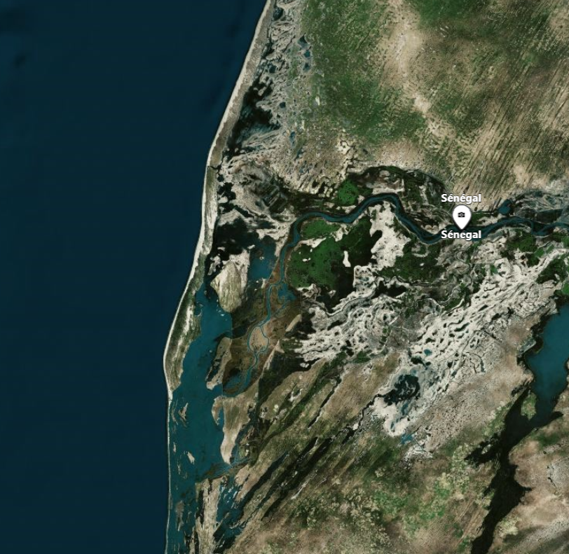
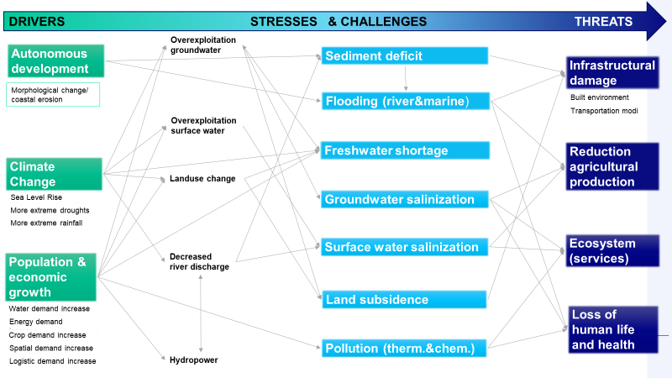
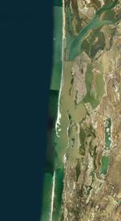
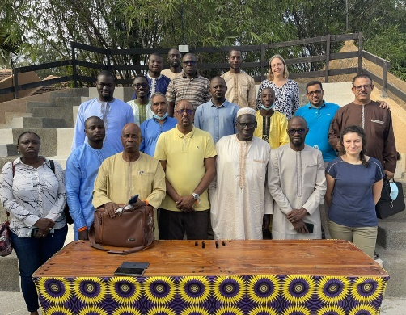
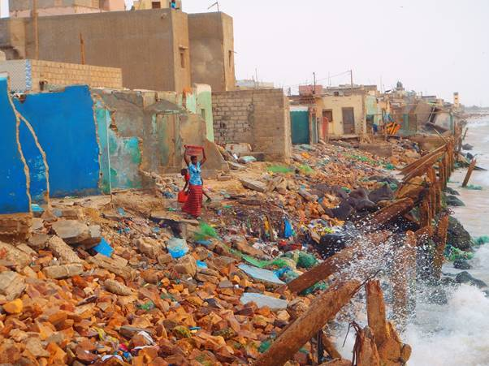
* Senegal River Watershed: 350000 km² * Shared between Guinea, Mali, Senegal and Mauritania * Length: 1800 km
Senegal
Delta Characteristics
Challenges/topics (select)
Coastal erosion
Current situation
Saint-Louis city: Severe coastal erosion along waterfront up to 4 m/y due to negative feedback loop. Sediment deficit and interaction with old seawall
Gandiolais region: Erosion along the Gandiolais coastline, due to southward migration new river mouth
Future situation
For Saint-Louis a positive impact is expected due to wave sheltering effects by a new offshore Gaz platform. However, enhanced erosion in the south is expected, due to picking up of transport
Migration of river mouth will expose Gandiolais villages
Enhancement of erosion due to sea level rise
Potential for Adaptation/Mitigation
Before 2035: Seawall reinforcements around the neighborhoods boarding the river, with seawall height up to 2m
After 2050: In case of expected high river discharge – identified by upstream monitoring – creation of breach through sandspit, a few kilometers south of Degounaye
PROGEP
OMVS Training
SERRP
Projects →

Slide 5
* Senegal River Watershed: 350000 km² * Shared between Guinea, Mali, Senegal and Mauritania * Length: 1800 km
Senegal
Delta Characteristics
Challenges/topics (select)
Coastal erosion
River flooding
Marine flooding
Salinization
Navigability
Env. degradation
Current situation
Saint-Louis city: Severe coastal erosion along waterfront up to 4 m/y due to negative feedback loop. Sediment deficit and interaction with old seawall
Gandiolais region: Erosion along the Gandiolais coastline, due to southward migration new river mouth
Future situation
For Saint-Louis a positive impact is expected due to wave sheltering effects by a new offshore Gaz platform. However, enhanced erosion in the south is expected, due to picking up of transport
Migration of river mouth will expose Gandiolais villages
Enhancement of erosion due to sea level rise
Potential for Adaptation/Mitigation
Saint-Louis city: Large beach nourishment ~2.5 Mm3 + around 2050: Dike heightening/groin if needed.
Gandiolais region : Periodic localized sand nourishments in front of villages
PROGEP
OMVS Training
SERRP
Projects →

Slide 6
* Senegal River Watershed: 350000 km² * Shared between Guinea, Mali, Senegal and Mauritania * Length: 1800 km
Senegal
Delta Characteristics
Challenges/topics (select)
River flooding
Current situation
High flood risk in the city of Saint-Louis, due to its location in and along the river, its low-lying neighboordhoods, poor state of seawalls and drainage system
Future situation
Increasing flood risk due to southward migration of the river mouth.
Up to 2050 larger river discharges are expected
After 2050 a potential decline in river discharge
Potential for Adaptation/Mitigation
Before 2035: Seawall reinforcements around the neighborhoods boarding the river, with seawall height up to 2m
After 2050: In case of expected high river discharge – identified by upstream monitoring – creation of breach through sandspit, a few kilometers south of Degounaye
PROGEP
OMVS Training
SERRP
Projects →

